Slide 1
Safer Communities
Increased safety support with ANPR
National Vehicle Intelligence Cloud

Slide 2






About NAVIC
National Vehicle Intelligence Cloud
NAVIC (Pty) Ltd was formed in 2016 to provide a security platform for communities, businesses and the government in the fight against crime in South Africa. The company has evolved into a complete ANPR and object analytic ecosystem with over 1.4 billion licence plate reads at a currently increasing average of over 100 million new image reads per month.
The company has evolved into a complete ANPR and object analytic ecosystem with over 1.4 billion license plate reads at a currently increasing average of over 100 million new image reads per month.
As one of the first ANPR providers in the country, NAVIC has built the largest unified licence plate recognition database in the country and continues to innovate and lead from the front. Our mission is to support communities, businesses and the government with a full services ecosystem in vehicle analytics in in an exceedingly demanding security industry.
NAVIC commits to honesty and fair play, adhering to business and technology best practices, and complying with the law, specifically the protection of citizens’ rights.
info@navic.cloud | www.navic.cloud | NAVIC (Pty) Ltd

Slide 3






NAVIC is a business process driven organisation. It is therefore not unexpected to see that NAVIC is the only ANPR (also known as LPR) provider to meet the following standards:
National Vehicle Intelligence Cloud
PSIRA Registered SASSETA Accredited
NQF L5 Accredited Training
The ecosystem has been conceptualised and designed by the brightest minds, with a strong operational management team delivering on the vision of safer communities. Our management team has collectively over 80 years of specialised investigations, policing and law enforcement experience, which has been instrumental in NAVIC’s ability to develop and deploy practical community policing tools that make a difference in our communities.
Proudly a Level 4 BEE contributor in accordance with the DTI's BEE code of good practice. (100% BEE procurement recognition level)
info@navic.cloud | www.navic.cloud | NAVIC (Pty) Ltd

Slide 4





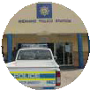









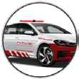
NAVIC cloud ecosystem
Retailers, Shopping Centres, Corporate
Landlords
Controlroom ( NNC)
Private Control Centres
Remote Alerts
SAPS, Law Enforcement, Security Firms, CPF, etc.
Local Datasources
BAC VOI
Fasle & cloned VOI
Other VOI
Crowd Datasources
SAPS
Metro
Civilian
Remote Datasources
SAPS Circulation System Via Zonke-Unicode
Private Shared Lists
Police
Metro
Private Service
Shopping Center Parking Lots
Border Post & Tollgates
On Site Remote Alerts SAPS, Law Enforcement, Security Firms, CPF, etc.

Slide 5





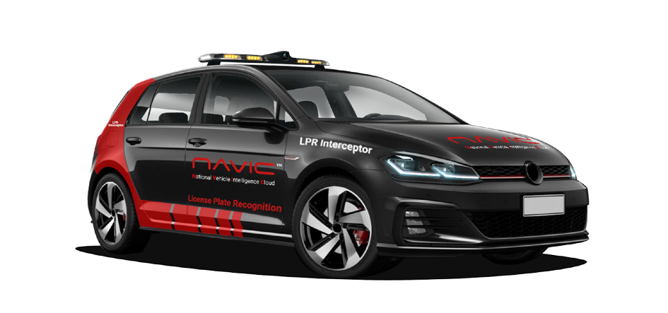





Crime prevention
National Vehicle Intelligence Cloud
NAVIC is passionate about crime prevention and works strictly according to MISS (Minimum Information Security Standardst) being the Act approved by parliament on the 4th of December1996. NAVIC provides the only independent ANPR/LPR platform that complies with this act. (see https://navic.cloud/ncmiss/)
Our technology and investigations tools are deployed nationally within: Policing Structures
Law Enforcement Structures Insurers and Financial Institutions Corporations
Multi-tenanted Landlords Critical Facilities
CPFs (Community Policing Forums) NHWs (Neighbourhood Watches) Entire Towns/Cities
info@navic.cloud | www.navic.cloud | NAVIC (Pty) Ltd

Slide 6



Our mission
National Vehicle Intelligence Cloud
NAVIC commits to honesty and fair play, adhere to business and technology best practices, and comply with the law specifically the protection of citizens’ rights. Should you feel that we have failed to achieve this please contact us immediately so we can address any issue.
Delivering on a promise:
To make a sustainable and meaningful impact.
Providing the most appropriate solutions using technology advancements. Continuously improve and secure NAVIC.Cloud and the complete ecosystem. Provide techniques for the integration of third-party tools and services that improve the ecosystem and break down “data silos” all while protecting the data.
Remain diligent and fierce protectors of the NAVIC.Cloud and the associate data we manage.
info@navic.cloud | www.navic.cloud | NAVIC (Pty) Ltd

Slide 7








The core
National Vehicle Intelligence Cloud
Security is like mowing the lawn; the job is never finished. It is with that in mind that we continuously develop the next generation system and structure with security and privacy as its core requirement such that we can move our PoPI Act compliant (Protection of Personal Information) system to GDPR (Data Protection Act to the EU General Data Protection Regulation) compliance. Our approach sets the bar for adherence to Standards and compliance :
Designed and supported by advanced Ai Algorithms to understand, learn and proactively manage and escalate incidents. Intelligence driven and verified database integration
Real time incident verification and distribution to business dependent operations Alert information and escalation in line with data protection and POPI act Innovation based hardware and software integration
The platform has been conceptualised and designed by the brightest minds with the goal of delivering a transactional, trusted service to multiple sectors globally through integration into a secure real-time environment.
info@navic.cloud | www.navic.cloud | NAVIC (Pty) Ltd

Slide 8














National Vehicle Intelligence Cloud
How it works
NAVIC’s technology and investigations tools are deployed nationally in residential, commercial and Law-Enforcement structures: NAVIC’s ANPR works by analyzing the camera data, which is then processed through a series of intelligent algorithms / ai.
LIVE
All encrypted data is untampered and securely stored on the Navic Cloud. Access depends on users credentials.
navic.cloud Control-Room NAVIC independent Control-Room
info@navic.cloud | www.navic.cloud | NAVIC (Pty) Ltd

Slide 9





National Vehicle Intelligence Cloud
24/7 Verification
1
2
3
4
STEP
Vehicle or object drives past ANPR camera or sensor
Camera sends Licence Plate information to Navic Cloud which holds a VOI (vehicle of interest) data base of suspect/wanted vehicles
STEP
STEP
If the Licence Plate matches a Vehicle of Interest (VOI) in the cloud, the alert gets sent to the control room
STEP
The operator verifies the information before sending the alert out to operational groups
info@navic.cloud | www.navic.cloud | NAVIC (Pty) Ltd

Slide 10















Solutions
National Vehicle Intelligence Cloud
Safer Farms
Improved Security Services
LIVE
Safety againts:
Farm attack
Stock theft
Poaching
Theft
Land invasion
Safety againts:
Assets in transit
Early warning system
Burglaries Investigations
Operation management
Safer Shopping
Centres
Improved Neighbourhood Watches
Mobile ANPR lightbar
Safety againts:
Armed robberies
ATM fraud
Shoplifting
Human trafficking
Theft out of vehicles
Safety againts:
Law enforcement lightbar
Security lightbar
Real-time alerts
Plug and play installation
Rental option available
LIVE
Navic ecosystem
info@navic.cloud | www.navic.cloud | NAVIC (Pty) Ltd

Slide 11




Mobile ANPR lightbar
Increased footprint with ANPR mobility
Automated proactive
alert system
The NAVIC ANPR lightbar delivers on mobility with a direct live system link. Onboard camera alerts are paired to the local Mobile Alert Room App to support proactive crime fighting.
Seamless systems integration delivers alerts checked against SAPS circulation and the ICB database.
Plug and play solution with complete hardware integration.
Internet ready and securely linked to the national vehicle intelligence cloud. Transform your reaction vehicle into a mobile control centre.
Law enforcement lightbar Security lightbar
Real-time alerts
Plug and play installation Rental option available
By receiving alerts, you can act proactively.

Slide 12
70 Victoria Street, Somerset West, Western Cape, 7130
info@navic.cloud | www.navic.cloud | NAVIC (Pty) Ltd

